Slide 1
How to format your data for R and Python
Tobin Magle, PhD
Research Computing Services
Download the Workshop Materials
https://github.com/nuitrcs/data-org-spreadsheets
inspired by the Data Carpentry Ecology lesson
https://datacarpentry.org/spreadsheet-ecology-lesson/
Notes:
Hi, and welcome to the workshop. I'm Tobin Magle, the Lead data management specialist in Research Computing Services at Northwestern University. Today we’re going to talk about good practices for using spreadsheets for data organization.

Slide 2
Main questions
How do you currently use spreadsheets?
Use a sample dataset with common scenarios
How do computers read spreadsheets?
Necessary for automation
How can you use spreadsheets to make them both machine and human readable?
Notes:
The main questions we're going to think about are:
- How do you currently use spreadsheets? We'll look at an example dataset with common scenarios
- THen we'll think about how computers read spreadsheets, which is necessary if we're thinking about automating our analyses
- And finally we'll talk about ways to tweak our human readable spreadsheets to make them more machine friendly

Slide 3
Poll: how do you use spreadsheets?
Q1: Do you use spreadsheets in your research?
In Chat: What do you use spreadsheets for?
Q2: Have you have ever done something to your spreadsheet data that has made you frustrated or sad?
In Chat: What was it?
Notes:
Poll:
Q1: Do you use spreadsheets in your research?
In Chat: What do you use spreadsheets for?
Q2: Have you have ever done something to your spreadsheet data that has made you frustrated or sad?
In Chat: What was it?

Slide 4
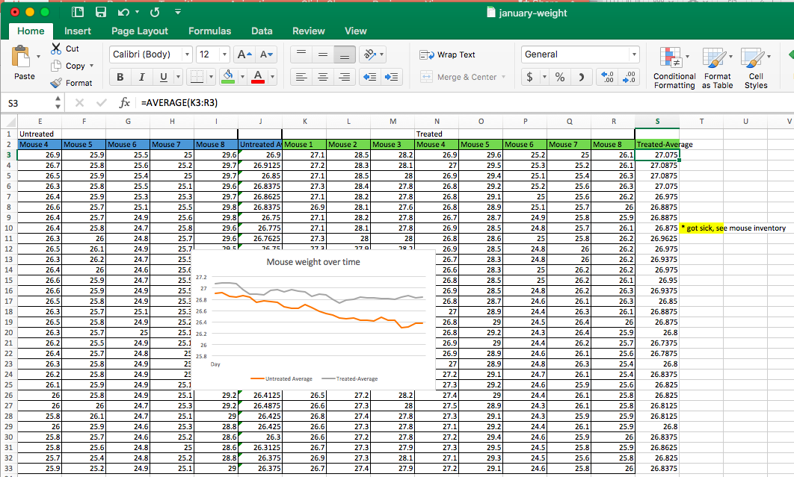
Common spreadsheet features
Data
Notes
Formatting
Color coding
Many tabs
Calculations
Graphs
Notes:
First, let’s talk about how spreadsheets are typically used: like a lab notebook.
· In addition to data, these spreadsheets contain color coding and formatting that often contain information about the data.
· They also have notes, calculations, graphs and tables.
· This is a very human readable and intuitive way to use a spreadsheet.

Slide 5
Pros: Human readable, all in one place
Data
Notes
Formatting
Color coding
Many tabs
Calculations
Graphs
Notes:
This is a very human readable and intuitive way to use a spreadsheet. It also keeps everything in one place

Slide 6
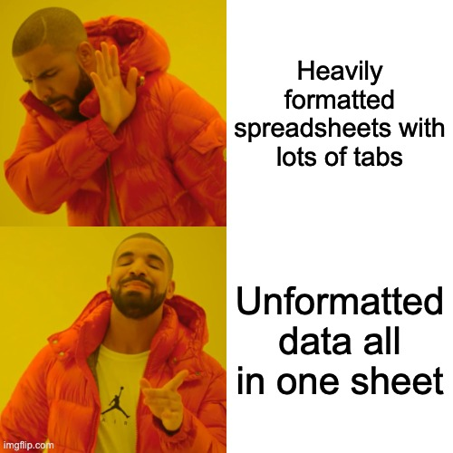
Con: Not machine-readable
Data
Notes
Formatting
Color coding
Many tabs
Calculations
Graphs
Computer
Computer
Notes:
Unfortunately, computers don't understand a lot of what humans put in spreadsheets. They're really only focused on the data itself and they expect a really specific structure.

Slide 7
Goal
Take a human readable spreadsheet
to
A machine readable table that can be used in R/Python
Human-readable
Machine-readable
Notes:
The goal of this lesson will be to take our lovely human readable spreadsheets and tweak them so that computers are able to read them as we automate our analyses.

Slide 8

Sample data: a survey of small mammals
Rows: observations of individual animals
Columns: Variables that describe the animals
Species, sex, date, location, etc
Inconsistencies in data collection
Notes:
To do this, we'll look at a sample spreadsheet from an ecological survey of small animals in a desert ecosystem.
· They are collecting variables like recorded species, plot, weight, sex and date
· For each animal observed, they should make a new row and collect the above variables
· However, different field technicians recorded the data differently, creating inconsistencies.

Slide 9
Download the sample data
https://github.com/nuitrcs/data-org-spreadsheets
Open the file in your spreadsheet program
Notes:
If you want to follow along, you can download this sample dataset from figshare, and open it in the spreadsheet program of your choice. I'll be using Excel today.

Slide 10
How does a computer read...?
Multiple tabs
Formatting
Multiple tables
Columns
Missing data
Notes:
As we look at this dataset, we're going to consider how a computer reads things like multiple tabs, formatting, multiple tables, columns and missing data.

Slide 11

How do I know what a computer can read?
Save data as .csv
R/Python read text-based file formats best
To get an idea of what R and python will see, save as .csv
Notes:
You might be thinking "How am I supposed to know what a computer can read?" A good first step is to save your spreadsheet in a .csv file, which is a common input to many data science programming language.

Slide 12
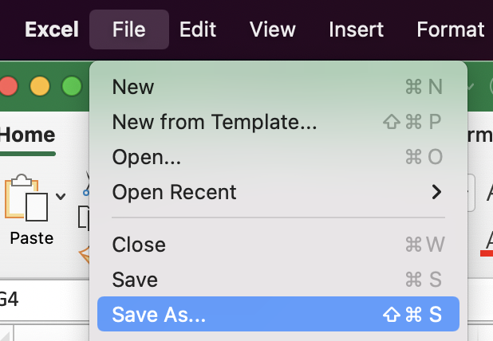
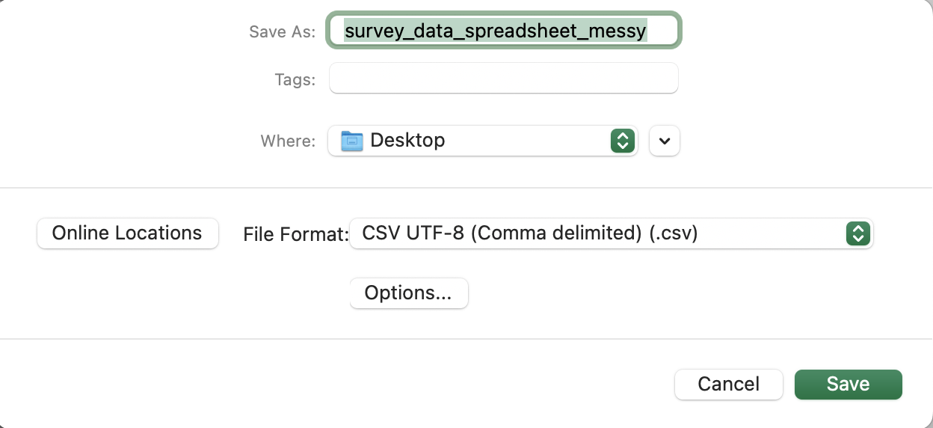
Demo: Save to .csv
Open the 2014 tab
File > Save as
File Format: csv
Notes:
Here, I'll demonstrate how to save a spreadsheet as a CSV file. Then we'll look at what happens to the data.

Slide 13
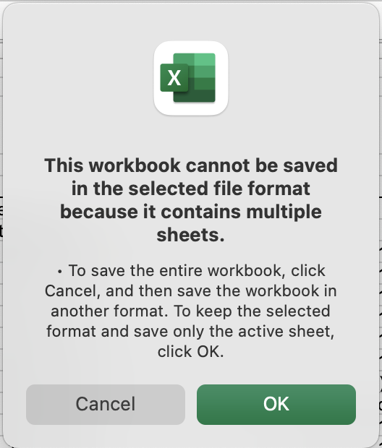
Demo: Save to .csv
Open the 2014 tab
File > Save as
File Format: csv
Notes:
The first thing you'll notice after selecting csv as a file format to save in is that Excel warns you that it can't save multiple sheets in this format. That's ok. We'll stick with the 2014 tab for now.

Slide 14
Restrictions with .csv files
One csv file per tab: if your data is in multiple tabs you have to export them separately
Creates extra work
Notes:
But now we know that if we have data spread across multiple tabs, they need to be exported separately, and combined later on in the analysis. You can save a step here by keeping all of your data in one tab.

Slide 15

Use tabs wisely
Keep the raw data raw
Allows you to go back if you make a mistake
Create a processed data tab
Keeps all the data in one exportable place
Create a notes tab
keep a log of how you processed the raw data with the data itself
Notes:
That isn't to say you should never use tabs.
In fact, you should keep your raw data as is so you can go back if you make a mistake while you're reorganizing
Make a new tab for the reorganized data
And keep a log of what you're doing to the data as you reorganize it in another tab so you can remember what you did later on

Slide 16
How does a computer read...?
Multiple tabs: it doesn't, keep one tab for processed data, notes and raw data in extra tabs
Formatting:
Multiple tables:
Columns:
Missing data:
Notes:
So, to recap, computers don't read multiple tabs automatically. It's best to keep your cleaned up data in one place so it's more efficient to export into analysis programs, but you can use other tabs to store raw data and notes to keep everything in one place.

Slide 17
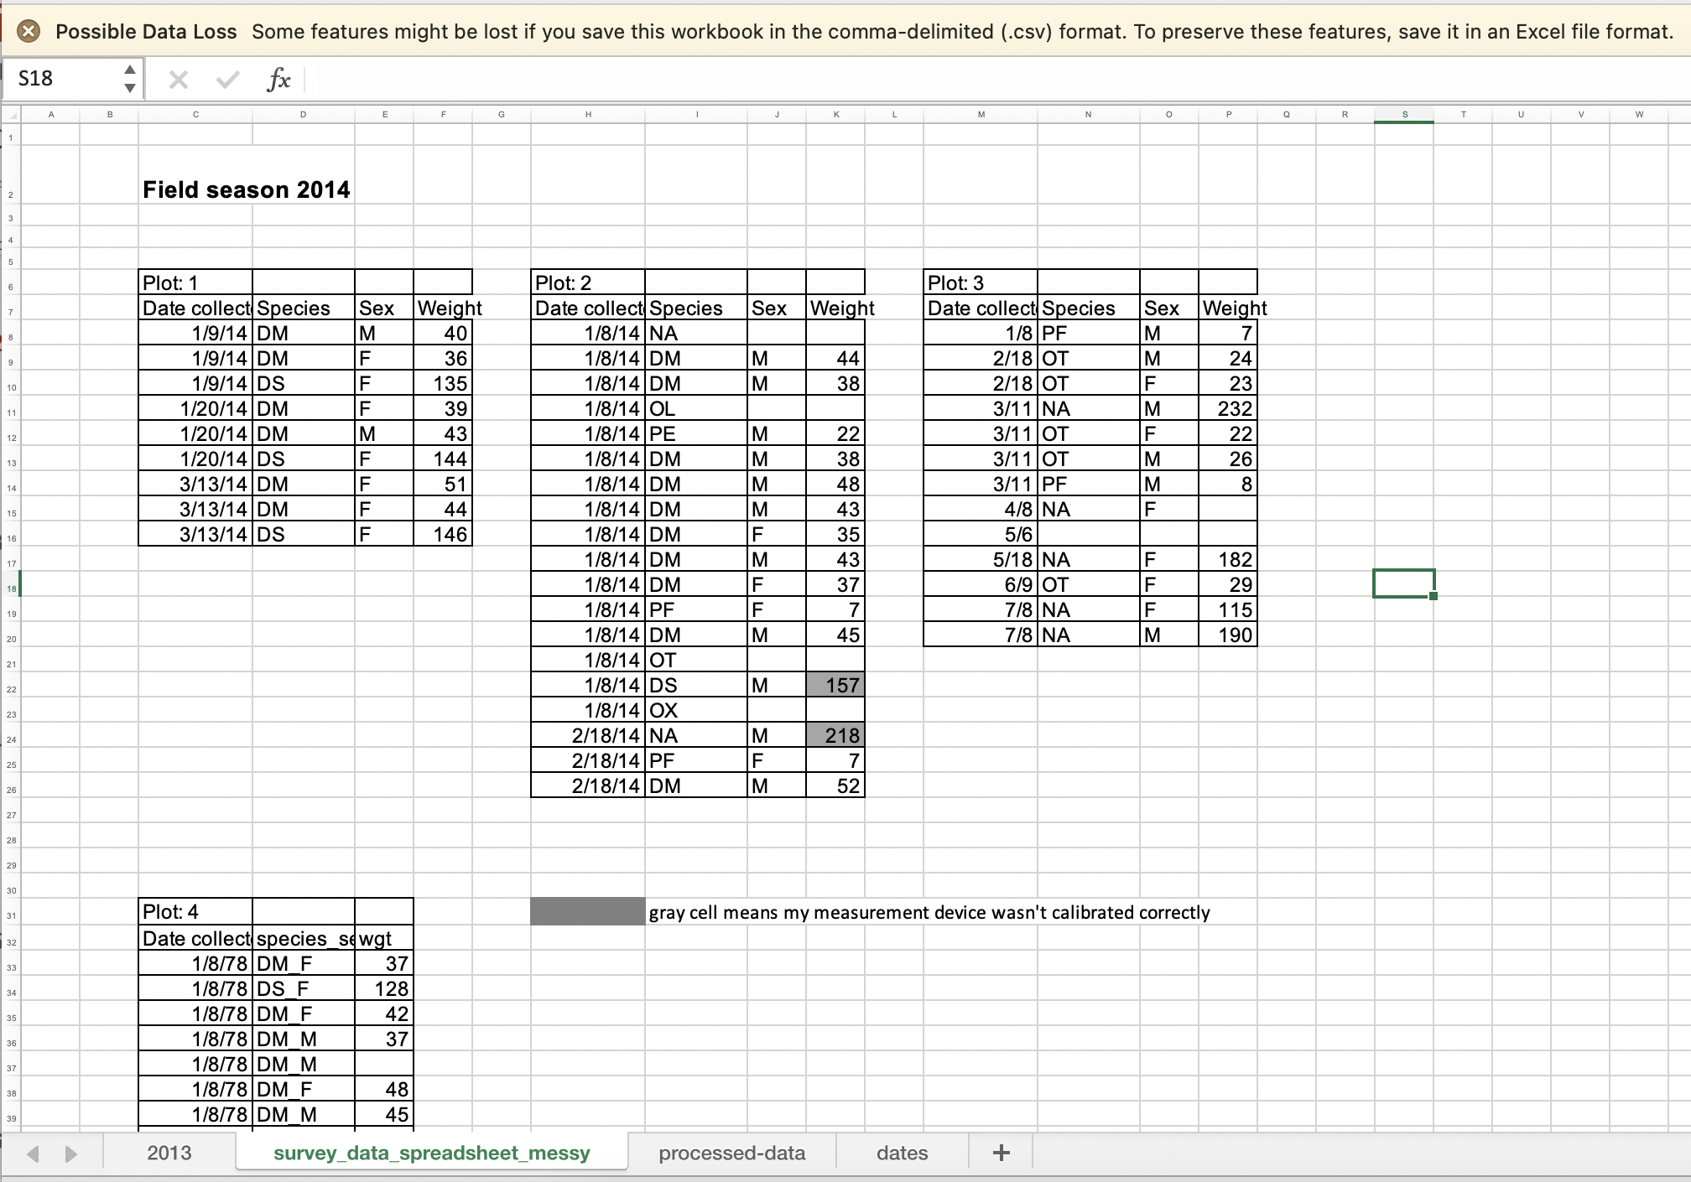
Demo: Save to .csv
Warning Message
Result:
Data Loss warning
Tabs and formatting are still visible
Tabs still present
Notes:
Let's go back to the spreadsheet. After you save the file as CSV, the display can be a bit misleading
- There is a warning about data loss at the top
- but all of the tabs are still present at the bottom. The one that you saved as a csv is renamed to the csv file name.

Slide 18
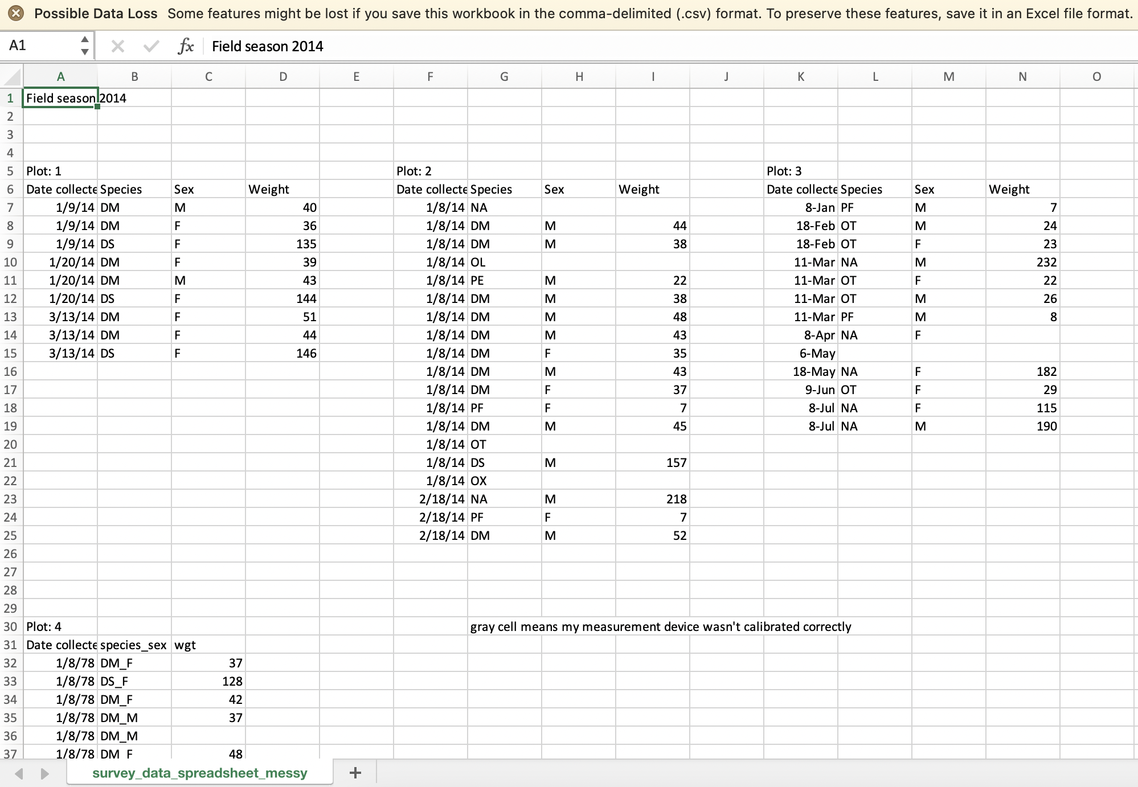
Demo: Save to .csv
Open the 2014 tab
File > Save as
File Format: csv
Close the file
Re-open .csv in spreadsheet program
No formatting
One Tab
Notes:
However if you close the file and reopen the .csv in a spreadsheet program, it looks a lot different
- The formatting is gone
- and there's only one tab
This is more or less what R and python can read.

Slide 19
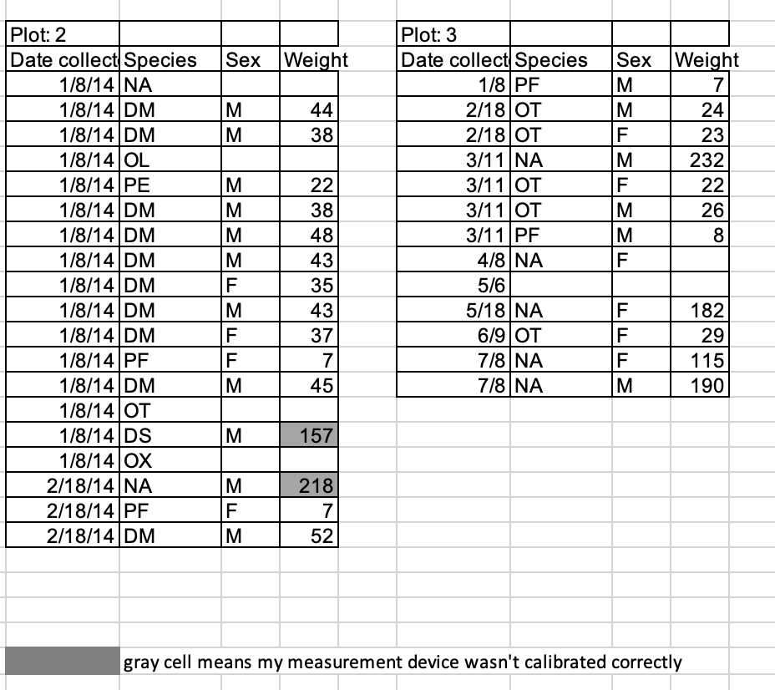
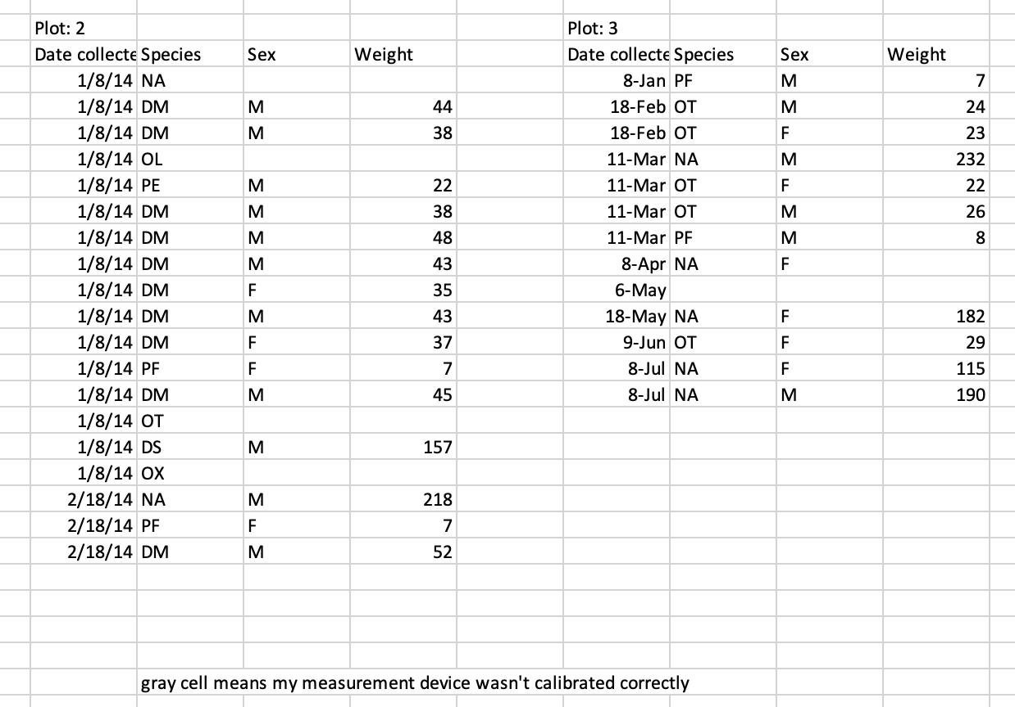
Data Loss
Spreadsheet
.csv
Notes:
Here's a side by side comparison of what the 2014 tab looked like before and after saving it as a csv. What information are we missing?

Slide 20
Restrictions with .csv files
One csv file per tab: if your data is in multiple tabs you have to export them separately
Creates extra work
Removes all the formatting: saves only the cell values, separated by commas in a text files, one line per row
Any calculations, highlighting, graphs, borders, bolding, color coding in your spreadsheet will disappear
Can cause data loss
Notes:
So, despite the initial view in Excel, all the formating is removed and the other tabs are not saved, which if you're not careful can lead to data loss. Luckily, the original spreadsheet is still there to go back to.

Slide 21
Q: How can I make it machine-readable?
Notes:
So how can we make the information stored in the formatting machine readable?

Slide 22
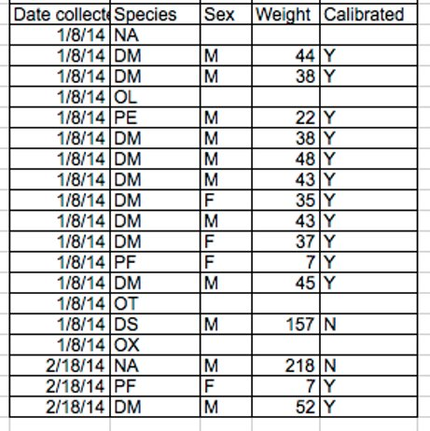
A: Add a column
Notes:
Solution: make a new column

Slide 23
How does a computer read...?
Multiple tabs: it doesn't, keep one tab for processed data, notes and raw data in extra tabs
Formatting: it doesn't, add a column
Multiple tables:
Columns:
Missing data:
Notes:
So to recap, if you're formatting your spreadsheet to convey meaning, remember that it could get lost when you export the data to a machine readable format. It's best to store all of this information in its own column.

Slide 24
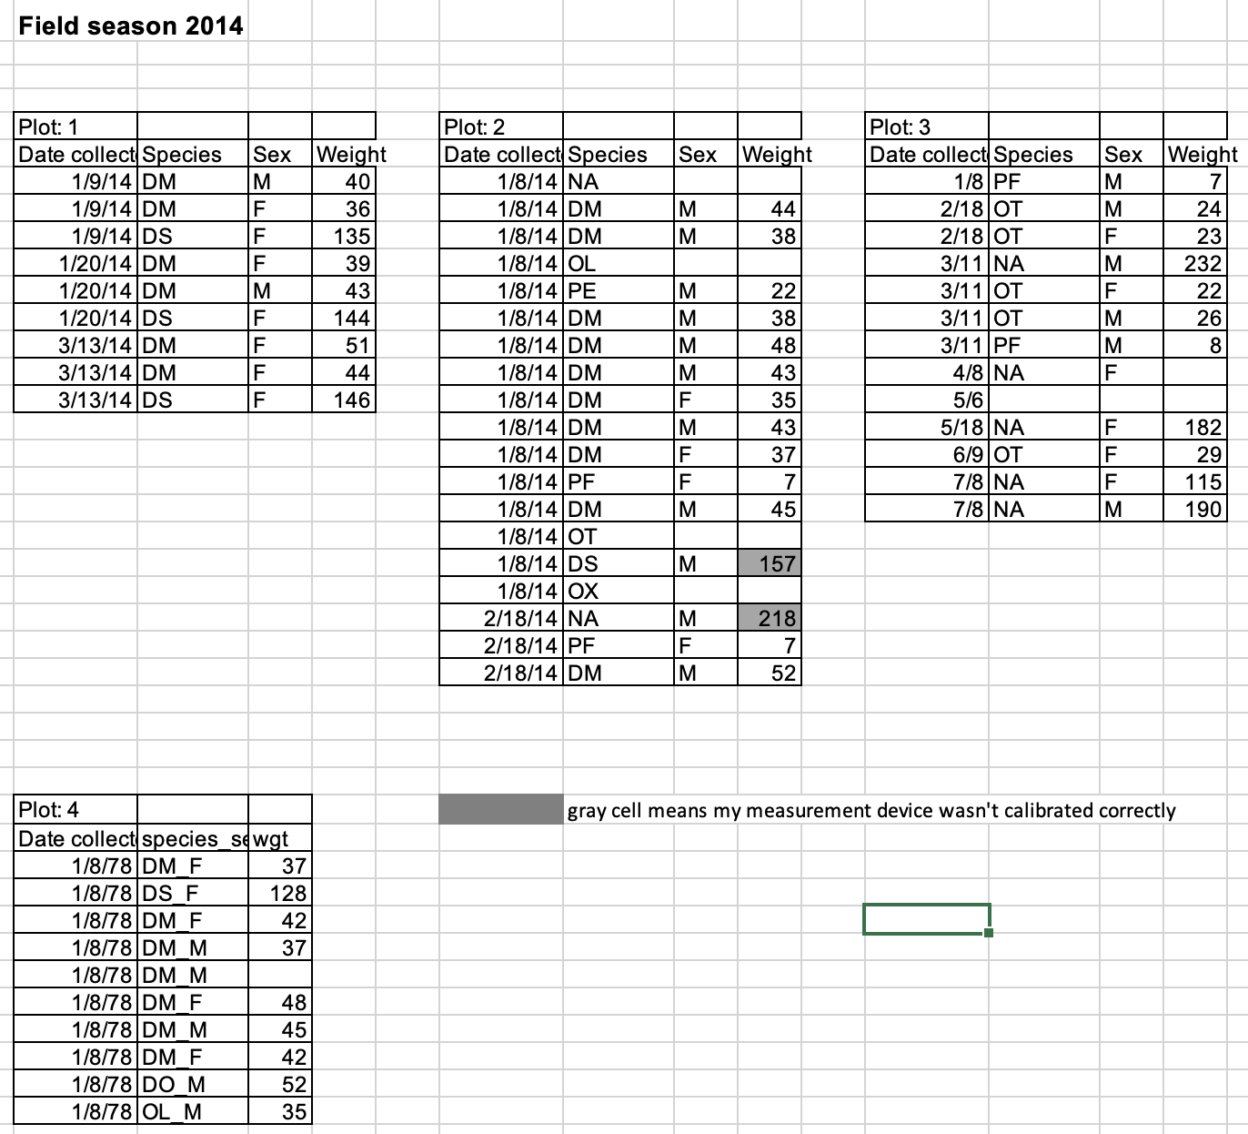
Multiple tables
Computers expect
One rectangular data table
One value per cell
One observation per row
One variables per column
Notes:
Now let's think about a situation where all of our data is in the same tab, but it's in separate tables. How would a computer read that?
Computers have some non-intuitive expectation about how to read data

Slide 25
Think like a computer
Computers expect
One rectangular data table
One value per cell
One observation per row
One variable per column
Notes:
First Computers expect one rectangular data table
- each row and each column have the same number of observations

Slide 26
Think like a computer
AS
AB | M | 23.4 | 12
AB
NL | F | 23.1 | 15
AS | M | 40.2 | 13
AB | F | 23.5
Computers expect
One rectangular data table
One value per cell
One observation per row
One variable per column
Notes:
They also expect that each cell in the table has one value

Slide 27
Think like a computer
AS
AB | M | 23.4 | 12
AB
NL | F | 23.1 | 15
AS | M | 40.2 | 13
AB | F | 23.5
Animal1
Computers expect
One rectangular data table
One value per cell
One observation per row
One variable per column
Animal2
Animal3
Animal4
Animal5
Animal6
Notes:
They also expect that each row of the table represents one data observation. In the sample data set, thus means that each row contains information about one animal that was trapped in their survey

Slide 28
Think like a computer
species
sex
weight
length
AS
AB | M | 23.4 | 12
AB
NL | F | 23.1 | 15
AS | M | 40.2 | 13
AB | F | 23.5
Animal1
Computers expect
One rectangular data table
One value per cell
One observation per row
One variable per column
Animal2
Animal3
Animal4
Animal5
Animal6
Notes:
Finally they expect to find one variable in each column. For example, they expect to find either all numbers or all text in each column and will assign it a "type" that will determine how that column can be analyzed.

Slide 29
Multiple tables
Read as one big table
Rows contain multiple observation
Doesn't have all the values for one variable in a column
Not analyzable
Notes:
So, if the computer reads this tab as one big tables
rows have multiple observations
And the variables are split among multiple columns
In short, a computer wouldn't be able to analyze this sheet in a useful way.

Slide 30
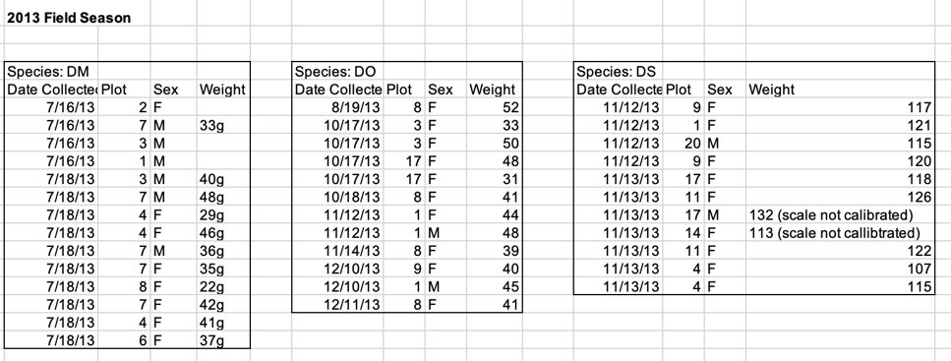
Q: What should the table look like?
How many animals were surveyed? -> # rows
What values are being collected for each animal? -> Variables
Notes:
So, how can we combine these tables into one large table?
- Think about how many animals were surveyed -> # rows
- Think about the values collected for each animal -> # columns

Slide 31
Breakout: Create a table
Make a new tab called "processed-data"
Combine the data from the 2013 and 2014 tabs into one table
How many animals were surveyed? -> # rows
What values are being collected for each animal? -> Variables
What questions came up for you while you were combining the data?

Slide 32
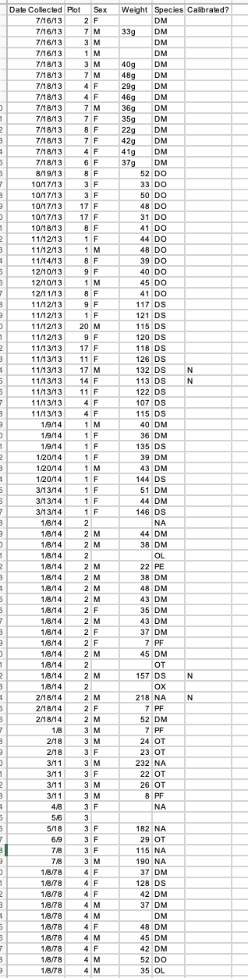
A: 88 Rows, 6 Variables
78 animals surveyed
Data collected for each animal: Date Collected, Plot, Sex, Weight, Species, Calibrated
Questions?
Notes:
If you consider the fact that computers only really understand “tidy” data, using multiple tables in one sheet can really confuse a computer
· Columns- duplicate column names, empty columns.
· Rows – creates false associations (row = observation)

Slide 33
How does a computer read...?
Multiple tabs: it doesn't, keep one tab for processed data, notes and raw data in extra tabs
Formatting: it doesn't, add a column
Multiple tables: as one big table, combine them!
Columns:
Missing data:
Notes:
To recap, computers will read many small tables in a sheet as one large table. Combine them into one consistent table

Slide 34
Columns
species
sex
weight
length
AS
AB | M | 23.4 | 12
AB
NL | F | 23.1 | 15
AS | M | 40.2 | 13
AB | F | 23.5
Computers expect
one variable per column
All values have the same type/format
Text = categories
Numbers = math
Notes:
Now let's think about how computers read columns. As we said before, computers expect one variable per column. Because they're measuring the same thing, computers also assume they will be the same datatype.

Slide 35
Column names
Column headers become variable names
Human readable: Aim for descriptive name
Avoid abbreviations
Machine readable: Avoid spaces and most special characters
Be consistent!
Naming convention | Example
Camel case | speciesName
Snake case | species_name
Kabob case | species-name
Dot case | species.name*
* Can cause issues in Python with pandas
Notes:
Computers are also picky about column names because they turn into variable names that you need to use when you're coding
- while most programs are pretty good at being flexible now a ways, it's easier to pick a good naming convention and sticking with it
- To keep it human readable, aim for a descriptive name that avoids abbreviation
- To keep it machine readable – avoid using spaces and special characters that can mess up your code.
- The table on the right lists some naming conventions that work with most coding languages.

Slide 36
Q: How can we improve this table?
Is each column a separate variable?
Is each value in the column the same type
Can a computer read the column headers?
Date collected | plot | Species-sex | Weight
Jan 9, 1978 | 1 | DM-M | 40
1/9/1978 | 1 | DM-F | 36 g
1/9/78 | 1 | DS-F | 135
1/20/78 | 2 | DM-M | 38g
1/20/78 | 2 | DS-f | .144 kg
03/13/1978 | 2 | DM-F | 44
3/13/78 | 2 | DS-F | 146
Notes:
Let's take a look at this table. How can we make its columns more easily computer readable?

Slide 37
A: Structural Changes
Use consistent header format
Make a column for each variable
date_collected | plot | species | sex | weight
Jan 9, 1978 | 1 | DM | M | 40
1/9/1978 | 1 | DM | F | 36 g
1/9/78 | 1 | DS | F | 135
1/20/78 | 2 | DM | M | 38g
1/20/78 | 2 | DS | f | .144 kg
03/13/1978 | 2 | DM | F | 44
3/13/78 | 2 | DS | F | 146
Notes:
First, let's look at the structure of the folumns
we can choose and apply a consistent naming convention for the columns.
Also, splitting species and sex into two columns will help analysis

Slide 38
A: Content changes
Make sure codes for male/female are consistent
Use a consistent format within columns
Make sure weights are numbers
date_collected | plot | species | sex | weight_g
1/9/1978 | 1 | DM | M | 40
1/9/1978 | 1 | DM | F | 36
1/9/1978 | 1 | DS | F | 135
1/20/1978 | 2 | DM | M | 38
1/20/1978 | 2 | DS | F | 144
3/13/1978 | 2 | DM | F | 44
3/13/1978 | 2 | DS | F | 146
Notes:
Now let's look at the content of the content of the columns
- you can see that the date format isn't standard, so we can change that
- also the sex column has a mix of captital and lower case letters. LEt's make them all upper case
- finally, the weight column has a mix of units and formats (some text some numbers). Let's convert them all to the same unit and put the unit in the header

Slide 39
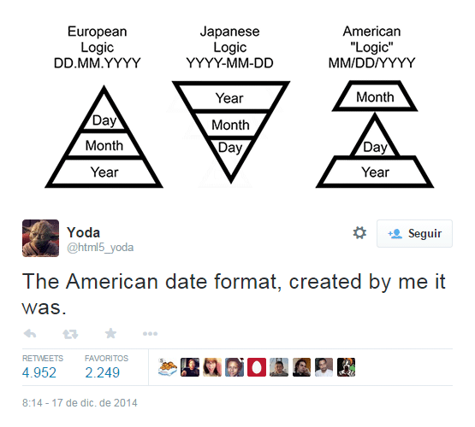
Dates are complicated
Date format varies by region
YYYY vs YY
Some include timestamps
Notes:
Let's take a moment to say a little more about dates: They're complicated
- Standard formats vary by region
- People use a mix of 2 or 4 digit date formats
- dates also occasionally use time stamps

Slide 40
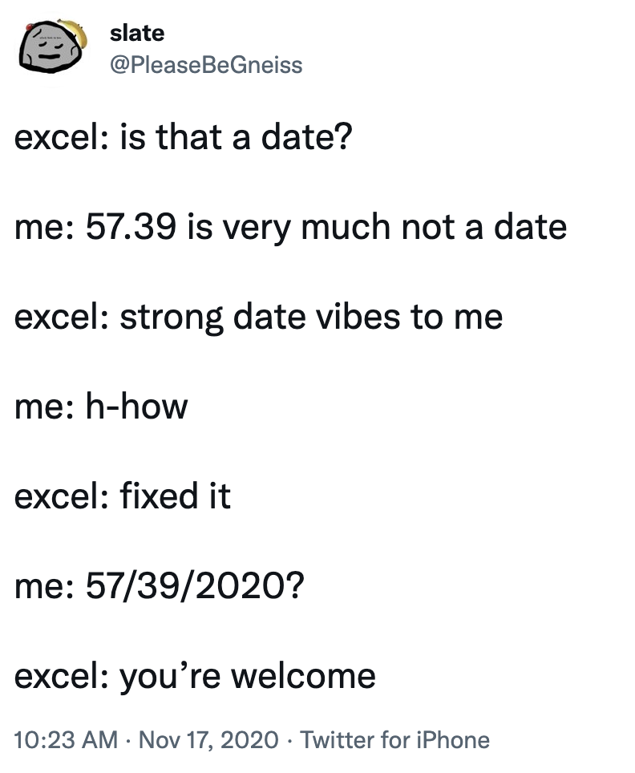
Dates in Spreadsheets
Spreadsheet software...
Interprets everything possible as a date
Date systems vary between versions of same software
Make assumptions
https://twitter.com/pleasebegneiss/status/1328735477923336192
Notes:
Additionally, spreadsheet software can cause additional concerns
- They can interpret things that are not dates as dates
- The date systems and how they work vary between software
- and they can make assumptions

Slide 41
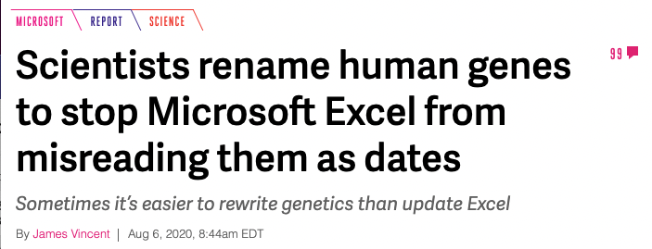
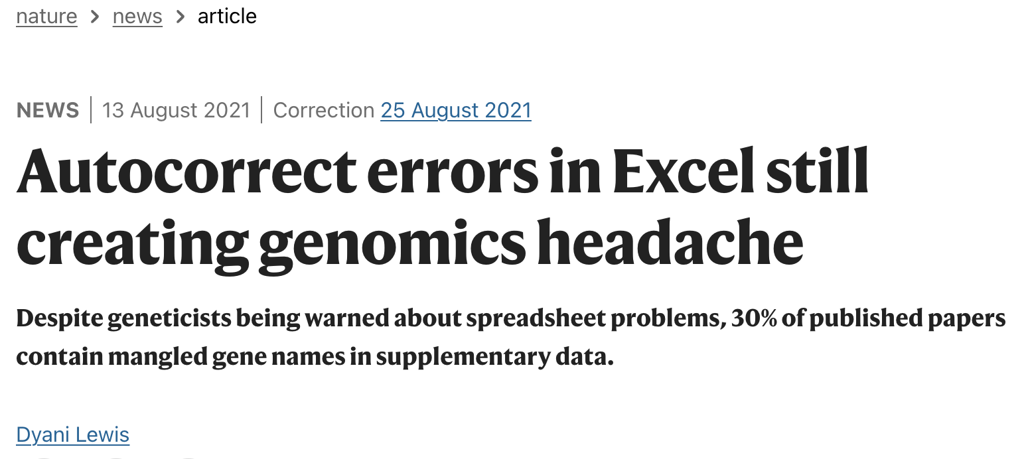
Example: gene names
Almost 1/3 of genomics papers have errors in gene names related to date "autocorrecting"
The gene names that resemble dates (MARCH-1, SEPT-1) have been changed to prevent this from happening
https://www.theverge.com/2020/8/6/21355674/human-genes-rename-microsoft-excel-misreading-dates
https://www.nature.com/articles/d41586-021-02211-4
Notes:
One of the biggest research impacts for this phenomenon can be seen in genomics
- a huge number of datasets have errors due to spreadsheet programs "autocorrecting" something that isn't a date to be a date
- as a result the names of human genes have changed to prevent this from happening going forward.

Slide 42
Demo: What year is it?
Open the "dates" tab in survey_data_spreadsheet_messy.xls
What year were the measurements taken?
Click File> Save As > Select .csv UTF-8 from the File Format Dropdown
Open the .csv file in a text editor (TextEdit or Notepad)
What year were the measurements taken?
Open the .csv file in a spreadsheet program (Excel, Numbers, Google Sheet)
What year were the measurements taken?
Notes:
Let's take a look at what happens to dates in our sample spreadsheet as we convert to CSV.

Slide 43
A: Safe dates
year | month | day | plot | species | sex | weight_g
1978 | 1 | 9 | 1 | DM | M | 40
1978 | 1 | 9 | 1 | DM | F | 36
1978 | 1 | 9 | 1 | DS | F | 135
1978 | 1 | 20 | 2 | DM | M | 38
1978 | 1 | 20 | 2 | DS | F | 144
1978 | 3 | 13 | 2 | DM | F | 44
1978 | 3 | 13 | 2 | DS | F | 146
Separate date into Day – Month – Year columns
Can be recombined later
Notes:
So, the safest way to store dates in spreadsheets is in separate columns for month, date and year

Slide 44
How does a computer read...?
Multiple tabs: it doesn't, keep one tab for processed data, notes and raw data in extra tabs
Formatting: it doesn't, add a column
Multiple tables: as one big table,
Columns: one variable per column, use consistent formatting
Be careful with dates
Missing data:
Notes:
So to recap, keep one variable per column and use consistent formatting, but also be extra careful with dates.

Slide 45
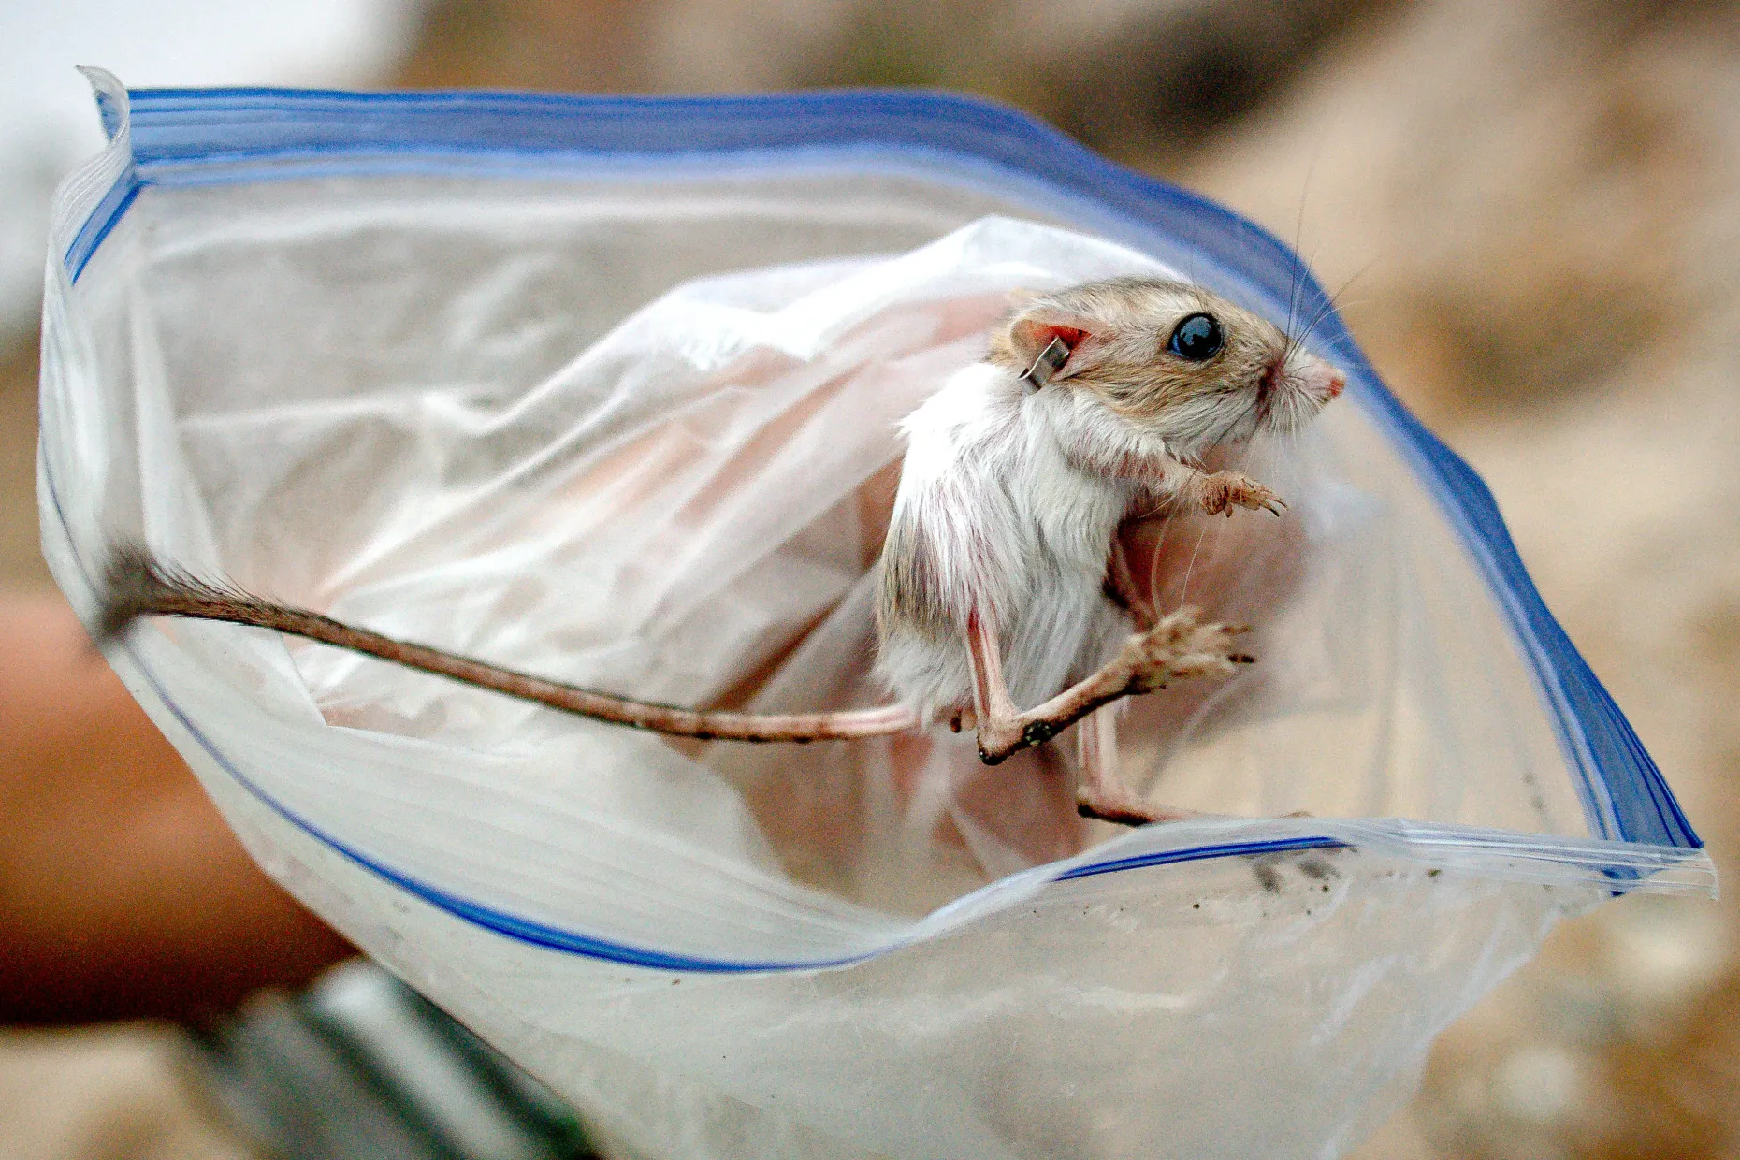
Missing Data
Example: A surveyed animal escapes after you identify the species and sex but before you can weigh it
How do you record this?
Use a Null Value
https://www.redlandsdailyfacts.com/2020/08/07/endangered-kangaroo-rats-now-wearing-backpacks-in-wash-near-redlands-highland/

Slide 46
Tips for picking null values
Null values are "symbols" that represent missing data
Make sure it's not a valid value
Programming languages have default Null values
R: NA
SQL: Null
Python: None
Avoid numbers (0, 999, -999), special symbols (*,+,-) and uncommon text labels
Notes:
It’s also important to pick a good symbol for null values
· Avoid numbers (especially) because it’s impossible to tell whether the value is actually that number or a NULL.
· Avoid special symbols and uncommon strings like “missing” because this can cause trouble with data types. For example, importing a number column into R would read in the column as text, not numbers.
· While strings like NA or NULL can cause the same data type problems I just mentioned, they are commonly used. Check what your stats program uses
· Overall, blanks (not spaces) are the best choice because they won’t cause data type problems. One issue is that it’s harder to tell if you forgot to enter the data or if you truly have a missing value.

Slide 47
Common Null values
Value | Compatible Language | Pros | Cons
Blank | tidyverse, pandas, SQL | Unlikely to be a valid value, easily read by common data science languages | Hard to know if it's missing data or accidentally deleted
NA | R, tidyverse, pandas | easily read by common data science languages | Could be a valid value
NULL | SQL | Default for SQL | Could be a valid value
None | Python | Default for Python | Could be a valid value
NaN | Pandas | Default for Pandas | Could be a valid value
Missing | Julia | Default for Julia | Could be a valid value
Notes:
It’s also important to pick a good symbol for null values
· Avoid numbers (especially) because it’s impossible to tell whether the value is actually that number or a NULL.
· Avoid special symbols and uncommon strings like “missing” because this can cause trouble with data types. For example, importing a number column into R would read in the column as text, not numbers.
· While strings like NA or NULL can cause the same data type problems I just mentioned, they are commonly used. Check what your stats program uses
· Overall, blanks (not spaces) are the best choice because they won’t cause data type problems. One issue is that it’s harder to tell if you forgot to enter the data or if you truly have a missing value.

Slide 48
How does a computer read...?
Multiple tabs: it doesn't, keep one tab for processed data, notes and raw data in extra tabs
Formatting: it doesn't, add a column
Multiple tables: as one big table,
Columns: one variable per column, consistent formatting
Be careful with dates
Missing data: it depends! Think about your data structure and what you will use to analyze the data
Notes:
Let’s quickly go over some other common data formatting problems
· Multiple tables: computer gets confused: combines multiple observations
· Multiple tabs: can create inconsistencies, creates extra step before data analysis
· Bad null values: for missing values
· Using formatting to convey info: create an extra column
· Bad variable names: not machines readable underscores and camel case

Slide 49
Need help?
Email: tobin.magle@northwestern.edu
Request a consultation: https://app.smartsheet.com/b/form/2f2ec327e6164f83b588b7bbe2e2b56f
Source material for this lesson: http://www.datacarpentry.org/spreadsheet-ecology-lesson/
Notes:
Thanks for listening. I hope you found this data organization session to be helpful. Please email me at the address on this slide if you need help. Also, check out our data management pages for more information. If you want to learn more about data
organization, check out the Ecology spreadsheet lessons from Data carpentry.

Slide 50
Exercise:
Think about your own spreadsheet data
OR
Pick an example from the next 2 slides
How can you make the data machine readable?

Slide 51
Example: Supplemental_data_1_xls
https://figshare.com/articles/Supplemental_data_1_xls/4055544
Description: “Table of the results given by HPLC analysis of the samples. Key: Rt, retention time; +, presence of peak; -, absence of peak.”
Notes:
Now let’s look at some examples of real data posted to FigShare, which houses real shared data. The first is supplemental data from a manuscript. This record contains high performance liquid chromatography data, which separates out molecules in solution to get an idea of how big they are. Primarily, they are measuring retention time, which is how long a molecule stays on the column. Let’s look at how these data are organized.
Demo: https://figshare.com/articles/Supplemental_data_1_xls/4055544
· Rt = Retention time
· + = presence of a peak
· - = absence of a peak
· Variables: Sample Code, Species, Sampling area, Altitude, Lat, Lon, Retention time
· Observation, whether there is a peak (+/-) at the combination of the variables above
· Lots of “extra” data. Could assume that no data = absence of a peak.
· Make new tab called processed
· Put variables across the top
o Copy A1 – A5
o Paste transpose
o Add retention time
· Instead of having a series of +/- for each combo of variables and each retention time, make a row for where each + sign is
o Each combo of variables can have more than one record.
o Hard to do by hand: scan for + , add records manually
o Easier to do in R.
o Results in way fewer data points -> efficient storage.

Slide 52
Example: cck8_xls
https://figshare.com/articles/cck8_xls/3505772
Description: “This data are from CCK-8 assay and ELISA.”
Notes:
This next dataset contains cytokine data from a CCK-8 assay and ELISA. It’s hard to say what all of these data mean, because the metadata are insufficient, but we’ll do our best.
Demo: https://figshare.com/articles/cck8_xls/3505772
· First, you can see they have multiple sheets, but sheets 2 and 3 are empty, so they can be deleted
· It also looks like they have 2 separate assays (CCK-8 and ELISA). I would make a separate sheet for each assay.
· Let’s start with the CCK8 data:
o Variables: Concentration (uC/ml), time, treatment, value
o Observations: value at a certain treatment, concentration and time
· For ELISA:
o Variables: Cytokine, treatment, value
o Observation: level of a specified cytokine given the treatment

